Slide 1
STUDENT BUDGET LIMITER
FOR ANDROID
README
(2021W) COMP-2430-WDE – MOBILE COMPUTING TECHNOLOGY
DMITRIY CHUYKO
STUDENT ID: 0888211
PROJECT IS NOT FINISHED
All the Information here is hypothetical.

Slide 2
OVERVIEW
The main purpose of this project is to create an Android application that will enable the students to check their budget and if necessary, enable the limiter to control the students spending habits. The effect is to enable the students to learn the importance of controlling their own budget, and if help is required in this regard, then program will assist in this endeavor.

Slide 3
TABLE OF CONTENT
Introduction
Application Design (Project description)
Program Scheme
Features list
Demo screenshots
Installation Instruction
Configuration instruction
Operating instructions
A manifest (list of files)
Contact information
Credits and acknowledgements

Slide 4
INTRODUCTION
In the current Digital age, online transaction are a common place and with advance of the smartphone technology, many people now can control their budget using their smartphone. However, standard Budget control programs are too complex and thus sometimes hard to fully understand how to operate the program. In fact, while the standard programs provide lots of functions, many are not being utilized and ignored. This in turn causes phone storage space to be waste.
So STUDENT BUDGET LIMITER FOR ANDROID is the simple version of the budget calculator that will only have:
User set Limiter for a chosen period
Manual input of the amount spent
Current balance of remaining money amount.
Warning message that will display if the limit has been reached/exceeded

Slide 5
APPLICATION DESIGN
Upon activating, the program will display a screen consisting of the Current Balance (initial balance upon first boot up) followed by the option to set the Limiter and option to enter the amount spent. The amount of the Current Balance is set to 15,000 CAD upon first activation, and will constantly update to a new balance after previous calculations. Limiter can be selected between 300 CAD per Day, 3K CAD per Week and 10K per Month.
Once the user has inserted all the necessary new information, the Data Base then will calculate the NEW Current Balance by:
Previous Current Balance – Amount Spent = New Current Balance
After acquiring the New Current Balance, the Data Base will compare the total amount spent with the Limiter, and if the selected limit has been reached or exceeded, the program will display the corresponding warning message.
Finally, once the Limiter completes its operation, user can reselect the new Limiter or extend the current one. The Limiter have their own set timer, and upon completion, they will reset to the default 3000 CAD per Week Limiter. This can be altered anytime.

Slide 6
PROGRAM SCHEME
Initial Balance
The program will have a initial balance upon first activation
WARNING
The program will display a warning to notify the user that the limit has been reached/exceeded
After accumulating the amount spent
New Current Balance
The balance of the current sum after previous calculation which will update the main screen’s current amount
Main Screen displaying Current Balance and options to [- Used Amount] screen and [Select Limiter] screen
IF
Sum >= Limit
Accumulator
The accumulator will add all the spent amount from
[-Used Amount Screen] and compare with the selected limiter
[Select Limiter screen]
Screen that will display 3 limit options
[-Used Amount screen]
Ask for input of how much money was spent
Calculator
The Current Balance will be calculated after subtracting the inputted amount from previous Current balance

Slide 7
FEATURES LIST
Current balance that displays the available sum (15,000 CAD upon first boot up)
User set Limiter for a chosen period
Manual input of amount spent
Warning message that will display if the limit has been reached/exceeded

Slide 8
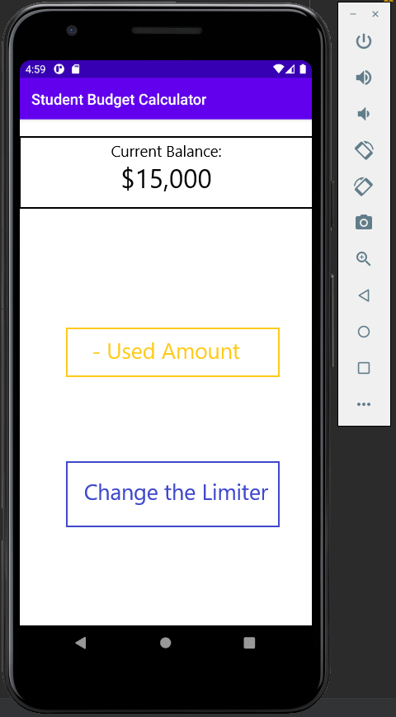
EXPECTED DEMO SCREENSHOTS
Displays the Current Balance
(sum upon initial activation)
Touch button to change into the amount subtraction screen
Touch button to change into the limiter selection screen

Slide 9
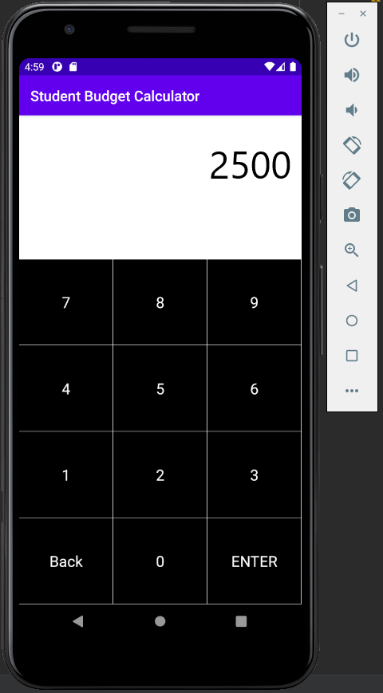
EXPECTED DEMO SCREENSHOTS
The [– Used Amount] screen will display a number pad for the user to enter the amount that has been spent and once pressed ENTER, the program will update the Current Balance

Slide 10
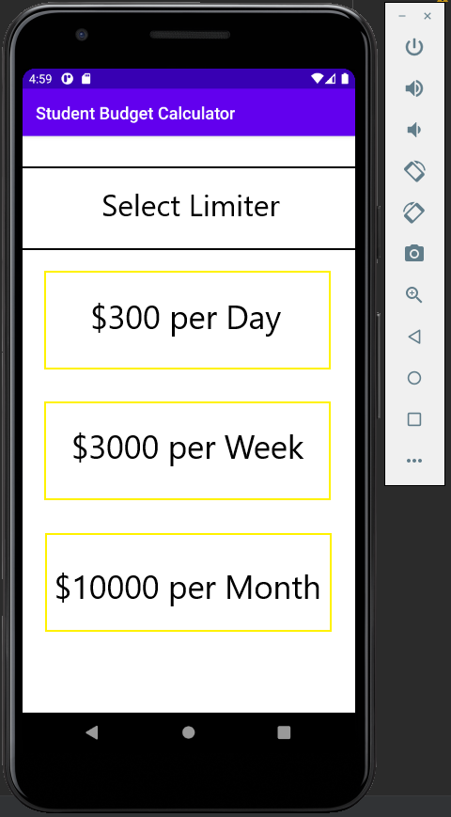
EXPECTED DEMO SCREENSHOTS
The Limiter Selection screen will display 3 limit options that have been preset in this program

Slide 11

EXPECTED DEMO SCREENSHOTS
The following screenshots are the steps that have been taken to show how the program is working
As shown above, the main screen after subtraction does not display any warning as the limit of $3000 per week limit that has been set has not been reached/exceeded

Slide 12

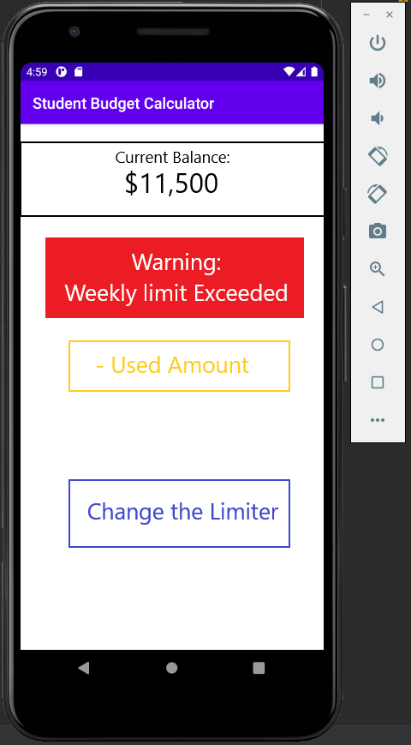
EXPECTED DEMO SCREENSHOTS
In this case, after subtracting additional $1000, a Warning message has popped up indicating that the limit has exceeded the set of $3000 per week

Slide 13
INSTALLATION INSTRUCTION
Install IntelliJ IDE
Install Android Studio into the IntelliJ IDE
Extract the codes from the GitHub, and insert them into the new empty project of Android Studio.
Once all the codes are slotted in the proper place, activate the program and have it installed onto your emulator.

Slide 14
PROGRAM CONFIGURATION
The program itself consists of 3 separate activities that display the lay out of the 3 (main, - Usage amount, limiter selection). 1 main activity to control the whole program which enable the program to calculate the sum, update the sum, and enable the touch button function.
There will be a color activity, which only controls the color of the text and design, while the Style activity only controls the general layout of the screens.
This is a simple project program and thus has 0 bugs or any sort of errors.

Slide 15
OPERATION INSTRUCTION
Once the program is activated, the program will display the Main screen, which contains Current Balance (preset to 15,000 CAD as initial balance) and will have two separate touch buttons underneath it. The limiter will also be set to 3,000 CAD per Week as initial limiter, but can be altered at any time.
The Yellow [- Used Amount] will direct you to the subtraction screen, where you will enter the amount you have spent. Once ENTER has been pressed, the program will subtract the entered sum from the Current Balance and automatically update the Current Balance after the subtraction has been completed.
The Blue [Change the Limiter] will direct you to the limiter selection screen, where you can alter the limiter of your program. The limiter currently has only 3 options but can be improved in the future

Slide 16
MANIFEST (LIST OF FILES)
List of required files for the proper installation can be found at my GitHub

Slide 17
CONTACT INFORMATION
DMITRIY CHUYKO
STUDENT ID: 0888211
(2021W) COMP-2430-WDE – MOBILE COMPUTING TECHNOLOGY
GitHub information
https://github.com/dchuyko97/Moblie-Final-Project

Slide 18
CREDITS and ACKNOWLEDGEMENTS
Credit goes to my professor Dr. Trevor M. Tomesh for his skills as a mentor and great teacher.
Acknowledgements:
The code for project has the elements from my personal Mobile assignment No.2.
Dr. Trevors various works during our classes, IE, Criminal Intent project which I have taken inspiration from in order to create my project.

